Slide 1
Microprocessor Architecture ECE4375/ECE5375
Dr. Argenis Bilbao
Spring 2026

Slide 2
Presentation Outline
ISA Basics
What is the CISC Processor?
Other CISC Processor Features
CISC Advantages and Disadvantages
How CISC Processors Work
Example ADD and MUL Instructions
Instruction Set and Addressing
Further Architectural Features

Slide 3
Instruction Set Architecture (ISA)
“Instruction Set Architecture is the structure of a computer that a machine language programmer (or a compiler) must understand to write a correct (timing independent) program for that machine.” - IBM, Introducing the IBM 360 (1964)
ISAs define:
Operations that the processor can execute
Data Transfer mechanisms + how to access data
Control Mechanisms (branch, jump, etc.)
“Contract” between programmer/compiler + HW

Slide 4
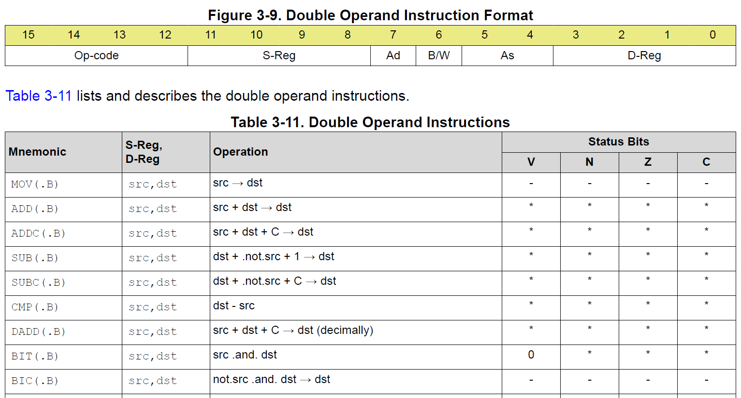
Instructions (MSP430)

Slide 5
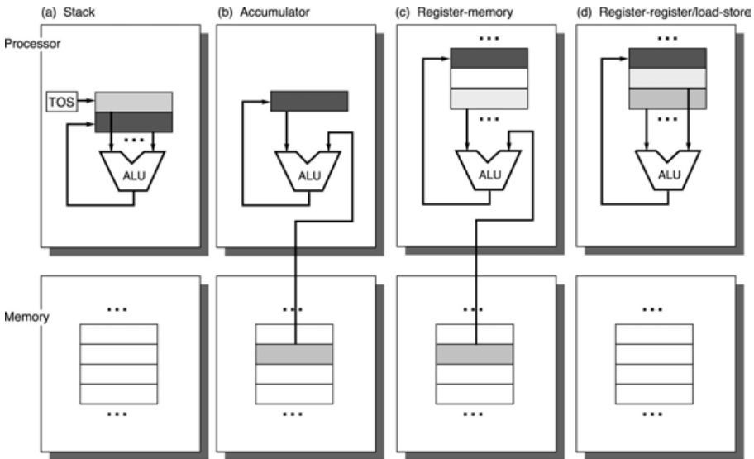
ISA Classification
Stack ISAs - The operands used are implicitly from the stack. Result stored in stack.
Accumulator ISAs - One of the operands originate from the accumulator. Result is stored in accumulator.
General Purpose Register (GPR) ISAs - All operands are explicitly mentioned, they are either registers or memory locations.
Example Instructions
Example:
PIC16F84
- See datasheet
Stack | Accumulator | GPR
PUSH A | LOAD A | LOAD R1,A
PUSH B | ADD B | ADD R1,B
ADD | STORE C | STORE R1,C
POP C | - | -

Slide 6
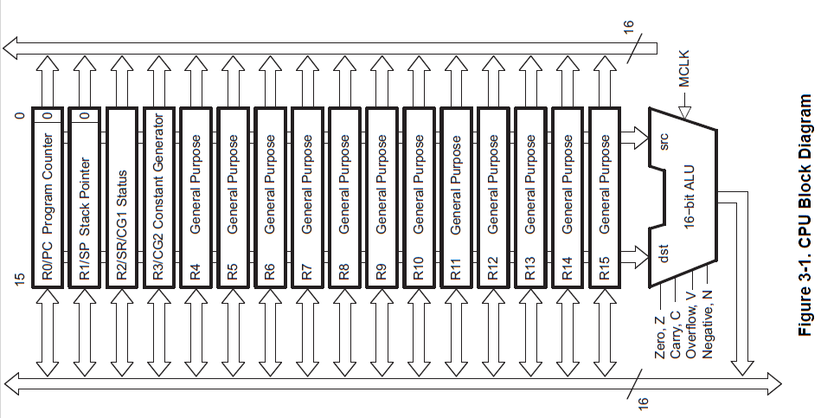
ISA Classification (MSP430)
General Purpose Register (GPR) ISAs - All operands are explicitly mentioned, they are either registers or memory locations.

Slide 7
Tradeoffs
Stack ISAs
Advantages: Simple expression evaluation and short instructions.
Disadvantages: Stack can't be randomly accessed. Hard to generate efficient code. The stack becomes a bottleneck.
Accumulator ISAs
Advantages: Compact instructions.
Disadvantages: The accumulator is only temporary storage. Memory bus can easily get congested through this approach.
GPR ISAs
Advantages: Efficient code generation is easy. Data can be stored for long periods in registers.
Disadvantages: All operands must be explicitly named leading to longer instructions.

Slide 8
Common Addressing Modes
Immediate LD R4, #0x1000
Register LD R4, R5
Autoincrement LD R4, (R2)+
Absolute LD R4, &0x1000
Register Indirect LD R4, (R1)
Base/Displacement LD R4, 100(R1)

Slide 9
What Makes a Good ISA?
Ease of Implementation (Job of Architect/Designer)
  Does the ISA lead itself to efficient implementations?
Ease of Programming (Job of Programmer/Compiler)
  Can the compiler use the ISA effectively?
Future Compatibility
  ISAs may last 30+yrs
  Special Features, Address range, etc. need to be thought out

Slide 10
Implementation Concerns
Simple Decoding (fixed length)
Compactness (variable length)
Simple Instructions (no load/update)
  Things that get microcoded these days
  Deterministic Latencies are key!
More/Less registers?
  Slower register files, decoding, better compilers
Condition codes/Flags

Slide 11
Programmability
1960s, early 70s
  Code was mostly hand-coded
Late 70s, Early 80s
  Most code was compiled, but hand-coded was better
Mid-80s to Present
  Most code is compiled and almost as good as assembly

Slide 12
CISC vs. RISC
CISC: Complex Instruction Set Architecture. Complex instructions that perform a lot of work.
RISC: Reduced Instruction Set Architecture. Simple/small number of instructions that don’t produce a lot of work.
Debate raged from early 80s through 90s
Now it is irrelevant
Despite this Intel (x86 => Itanium) and DEC/Compaq (VAX => Alpha) have tried to switch
Research in the late 70s/early 80s led to RISC
  IBM 801
  Berkeley RISC-1
  Stanford MIPS

Slide 13
CISC Processor
CISC stands for Complex Instruction Set Computing. CISC processors were launched in 1970 and can perform complex tasks with relatively few instructions (without using multiple codes). The aim of this architecture is to create an instruction set that functions seamlessly with higher-level languages and data structures.
It can use instructions that are different lengths:
Register-based instructions can be as short as 2 bytes
Instructions with two memory addresses can be 5 bytes for the complete code
As instructions can be of different lengths, the execution time can also vary. Many will use more than one clock cycle.

Slide 14
Other CISC Processor Features
Another unique feature is direct access to operands in memory. This reduces the difficulty of software (compilers) to convert high-level commands to machine-level instructions.
An instruction can add a number stored in memory and another in a register. And finally, save our result to some location in memory.
So, rather than working with processor registers that are inside the processor, many CISC processor instructions work directly with computer memory to take in and send out information.

Slide 15
CISC Advantages and Disadvantages
Advantages of CISC architectures:
  Reduced program size as complex instructions can perform multiple operations
  Easier assembly language programming due to the availability of high-level instructions
  Backward compatibility with existing software
Disadvantages of CISC architectures:
  Complex hardware design results in slower clock speeds and higher power consumption
  Longer instruction decoding time negatively impacts performance
  Difficulty in implementing efficient pipelining due to variable-length instructions and complex dependencies

Slide 16
How CISC Processors Work
CISC processors perform their tasks through repeating cycles:
Program Counter (PC): It holds the instruction address to be fetched next.
Instruction Fetch: Then, the instruction is loaded from memory into the data bus and sent to the decoder.
Instruction Decoding: The decoder generates a control word for the operation to perform. It also generates the control signals required to perform memory operations.
Execution: Finally, the operation takes place. If required, it may fetch more data and store the result in memory.
PC Update: The Program Counter gets the next address, gets latched, and the cycle goes on.

Slide 17
Example of ADD and MUL Instructions
Let’s say you need to add two 8-bit numbers. In a CISC processor, you can get it done by using a single instruction only (instead of many).
For that, you can use commands like ADD and tell the processor where the numbers are stored in memory and where to put the results.
The processor will go to the memory, grab the two numbers, add them together, and store the result – within that one instruction.
Similarly, for multiplication, you can use this command: MUL 0x100, 0x200. How does it perform?
It multiplies the value at 0x100 by the value at 0x200 and stores the result WITHOUT any load/store commands.
The entire operation is directly manipulated in memory.

Slide 18
Instruction Set and Addressing
CISC processors have several key features that set them apart. Let’s take a look at them and then understand with an example.
Large Instruction Set: Typically, 100 to 250 instructions are available.
Specialized Instructions: Some instructions are used rarely but support unique or advanced operations.
Several addressing modes: It generally ranges between 5 and 20 and can be used for flexible design.
Variable-Length Instructions: It can also vary depending on what kind of task you’re doing or how the data is being accessed.
Memory Operations: Many instructions can directly work with the data in memory. It means that you don’t always need to move the data to a faster register first. This saves time and simplifies the process.

Slide 19
Further Architectural Features
Complex Instruction Decoding: Due to variable-length and complex instructions, decoding logic is intricate.
General-Purpose Registers: CISC processors don’t need as many of these registers because they do most of their work directly with memory instead of using registers for temporary storage.
Special Purpose Registers: These are specific registers for special tasks. For example, some registers help manage things like the program’s stack (which keeps track of data), handle interruptions, or record important details like the result and status of operations (this is called the Condition Code Register).
Multiple Data Types: CISC processors handle varied data types with their extensive instruction sets.
Limited Register Use: Chip space is mostly dedicated to instruction decoding, execution, and microcode storage.
Multiple Clock Cycles: Some instructions require more than one clock cycle to complete.
Condition Code Register: It is used to store certain conditions, like whether the last result was negative, zero, or positive. It also flags errors if any.
Special Registers: They’re used for particular tasks, such as tracking the stack (where data is kept) or dealing with interruptions.

Slide 20
Example CISC Machine
https://trainer4edu.com/dragon12/dragon12_light_9s12/index.html
Of course the x86 architecture!

Slide 21
Sources
http://www.eecs.harvard.edu/cs146-246/
Assigned Textbook
Wikipedia
https://www.google.com/
https://www.stromasys.com/resources/breaking-down-the-features-and-architecture-of-cisc-processor/
Assigned Textbook
https://fiveable.me/introduction-computer-architecture/unit-3/risc-cisc-architectures/study-guide/w3HvrwVqcuP6lBNL

